Slide 1
Face Detection Based on AdaBoost Algorithm
Presented by Team 19
November 23rd 2019

Slide 2



Outline
Introduction/Background
2
Method
3
Experiments and Discussions
4
Conclusion

Slide 3
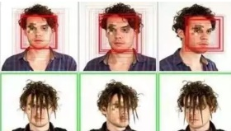
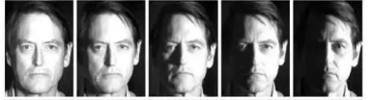

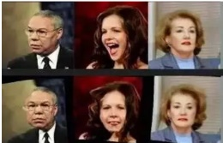

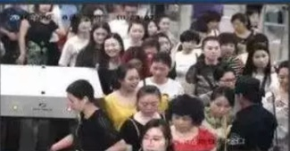
Introduction
Face recognition has been one of the most interesting and important research fields in the past two decades. The reasons come from the need of automatic recognitions and surveillance systems, the interest in human visual system on face recognition, and the design of human-computer interface, etc.
However, there’re several problems in the field that we have no choice but to deal with.
Illumination
Poses
Occlusion
Expression
Age
Dynamic Recognition

Slide 4
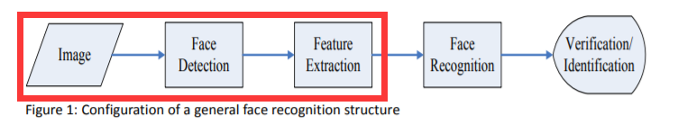
Introduction
Towards the goal, we generally separate the face recognition procedure into three steps: Face Detection, Feature Extraction, and Face Recognition
In this lab, we focus mainly on Face Detection and Feature Extraction, and build an Adaboost model to address the problem.

Slide 5
Outline
Introduction/Background
2
Method
3
Experiments and Discussions
4
Conclusion

Slide 6
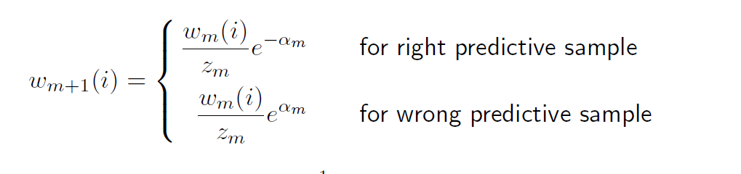
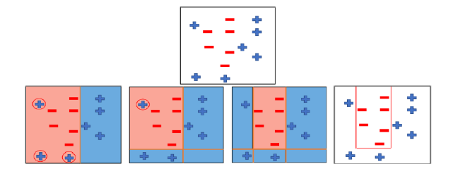
Method——Adaboost
Outline
In an Adaboost model, we construct a base learner each round. At the
end of each round, we calculate the error rate and a parameter α which acts like the weight of base learners for this specific base learner.
Finally, we make the wrong predictive samples more important, and handle it in next round:
Wrong predictive samples
Original
Final Classification
First Round
Second Round Third Round

Slide 7
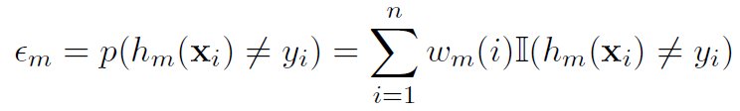

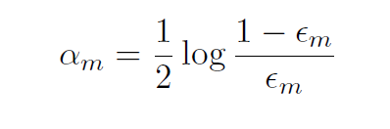
Method——Adaboost
Important Formulas
After the construction of base learner each round, we use the formula
below to compute the error rate of the base learner.
The error rate is a vital indicator to evaluate the goodness of the base learner.
Thus we compute the α according to the error rate.
We can find that by using the formula, we make the base learner with lower m more important

Slide 8
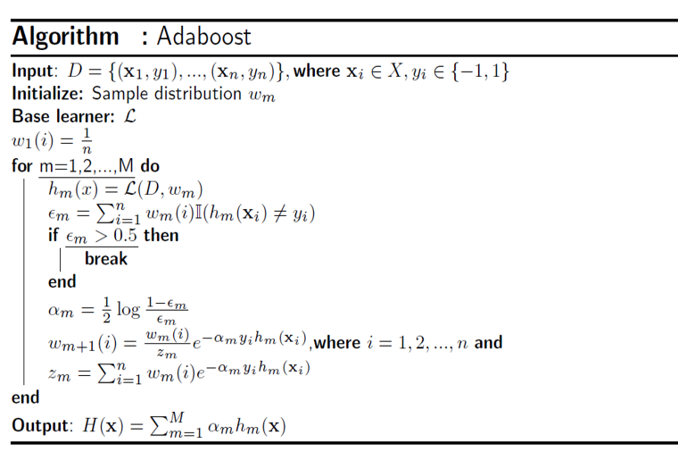

Method——Adaboost
Final learner
Integrate all the base learner we built, we can accomplish the final learner.

Slide 9
Outline
Introduction/Background
2
Method
3
Experiments and Discussions
4
Conclusion

Slide 10
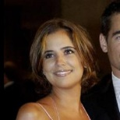



Evaluation Metrics
signal-to-noise ratio(SNR)
Dataset——
We download 500 face images and 500 non-face images as our dataset.
And we preprocess them to make it easier to extract features.
Face images
250*250
Nonface images
32*32
All 32*32
Grey images

Slide 11
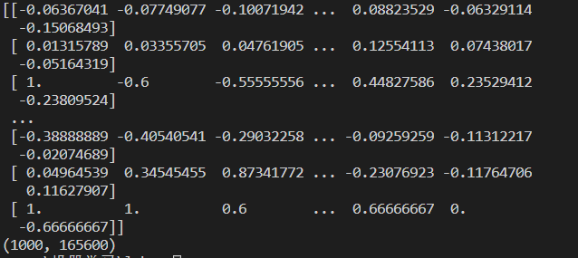
Evaluation Metrics
signal-to-noise ratio(SNR)
Implementation and Discussions
Step 1 : Extract NPD features of all pictures and store them in a numpy array.
Step 2 : Split the raw data into two sets --- the training set and the testing set.
Here we shuffle the original data and randomly pick 900 images as training set and 100 images as testing set
Training set(900)
Testing set(100)

Slide 12
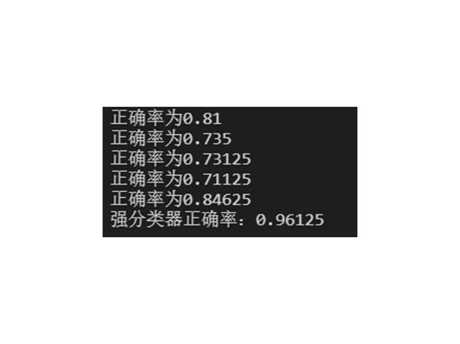
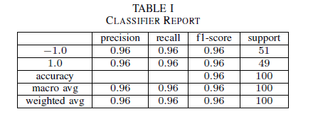
Evaluation Metrics
signal-to-noise ratio(SNR)
Implementation and Discussions
Step 3 : Train the base learners and assemble them as a final learner.
Here we use sklearn.tree. DecisionTreeClassifier as our base learners.
Step 4 : Use the final learner to conduct detection on the testing set.
Get our final result!

Slide 13
Outline
Introduction/Background
2
Method
3
Experiments and Discussions
4
Conclusion

Slide 14
Conclusion
This section summarizes the presentation. In our experiments, you can also share your gains and inspirations in here.

Slide 15
Thank You
Thank you for your attention!

